Slide 1
Village Council
Meeting
October 5, 2021

Slide 2
Plat of Subdivision,
Planned Unit Development,
Rezoning & Special Use
2751 – 2761 Ogden Avenue

Slide 3
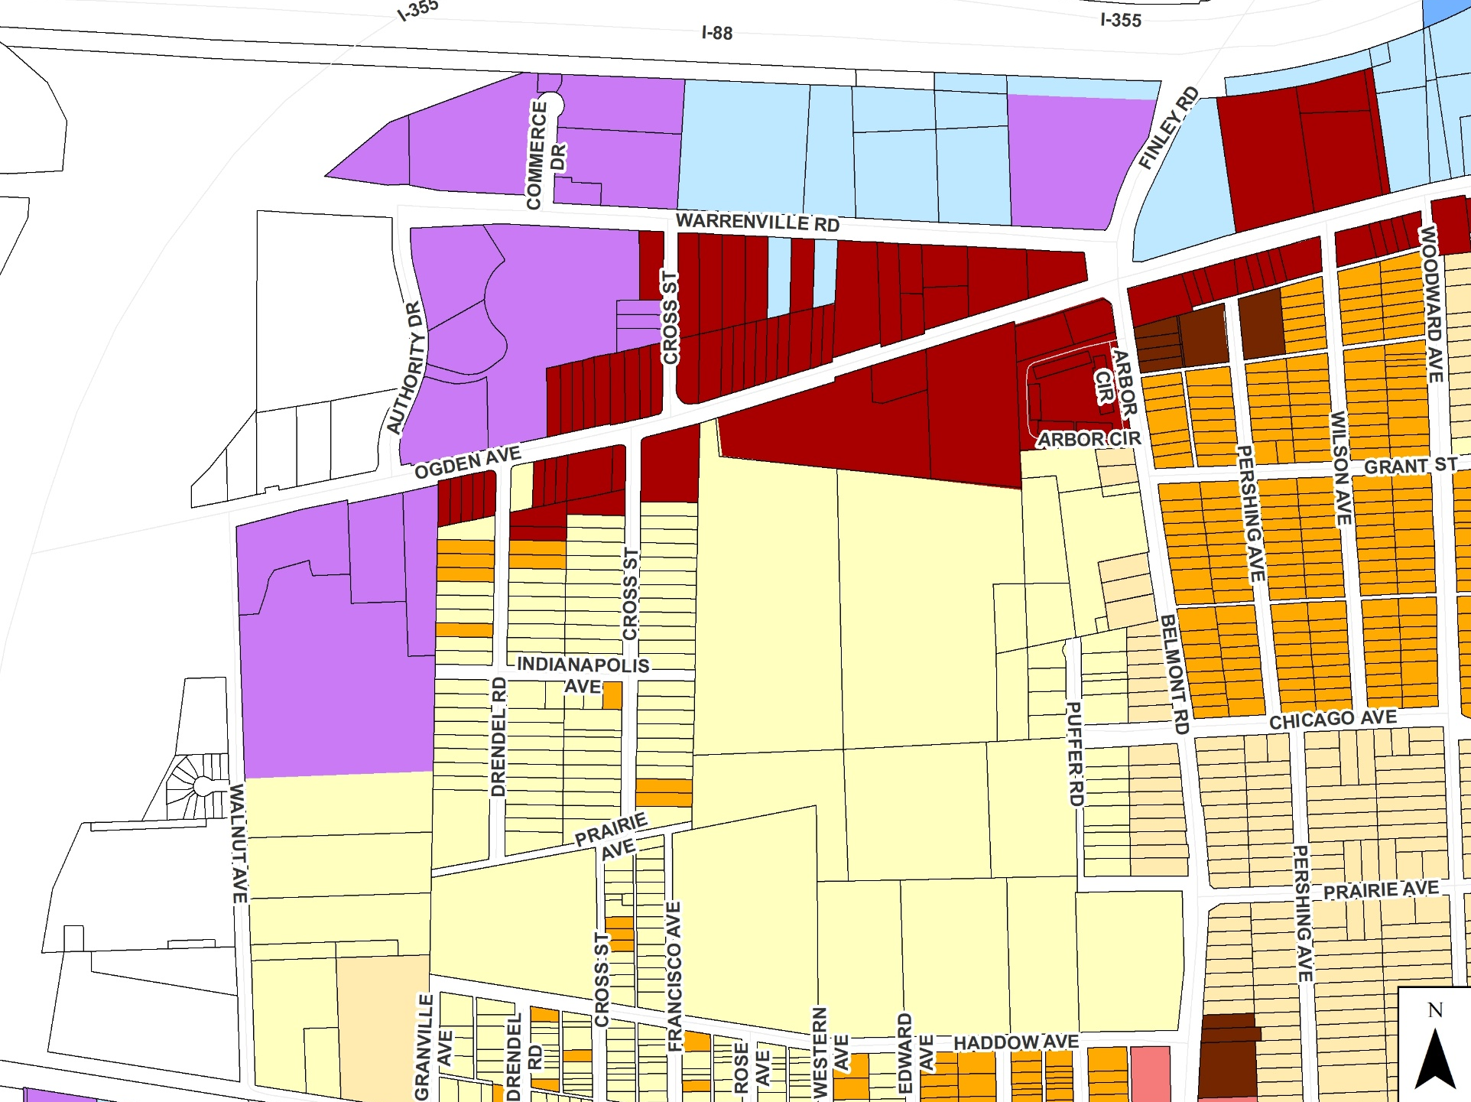
2751 – 2761 Ogden Ave

Slide 4
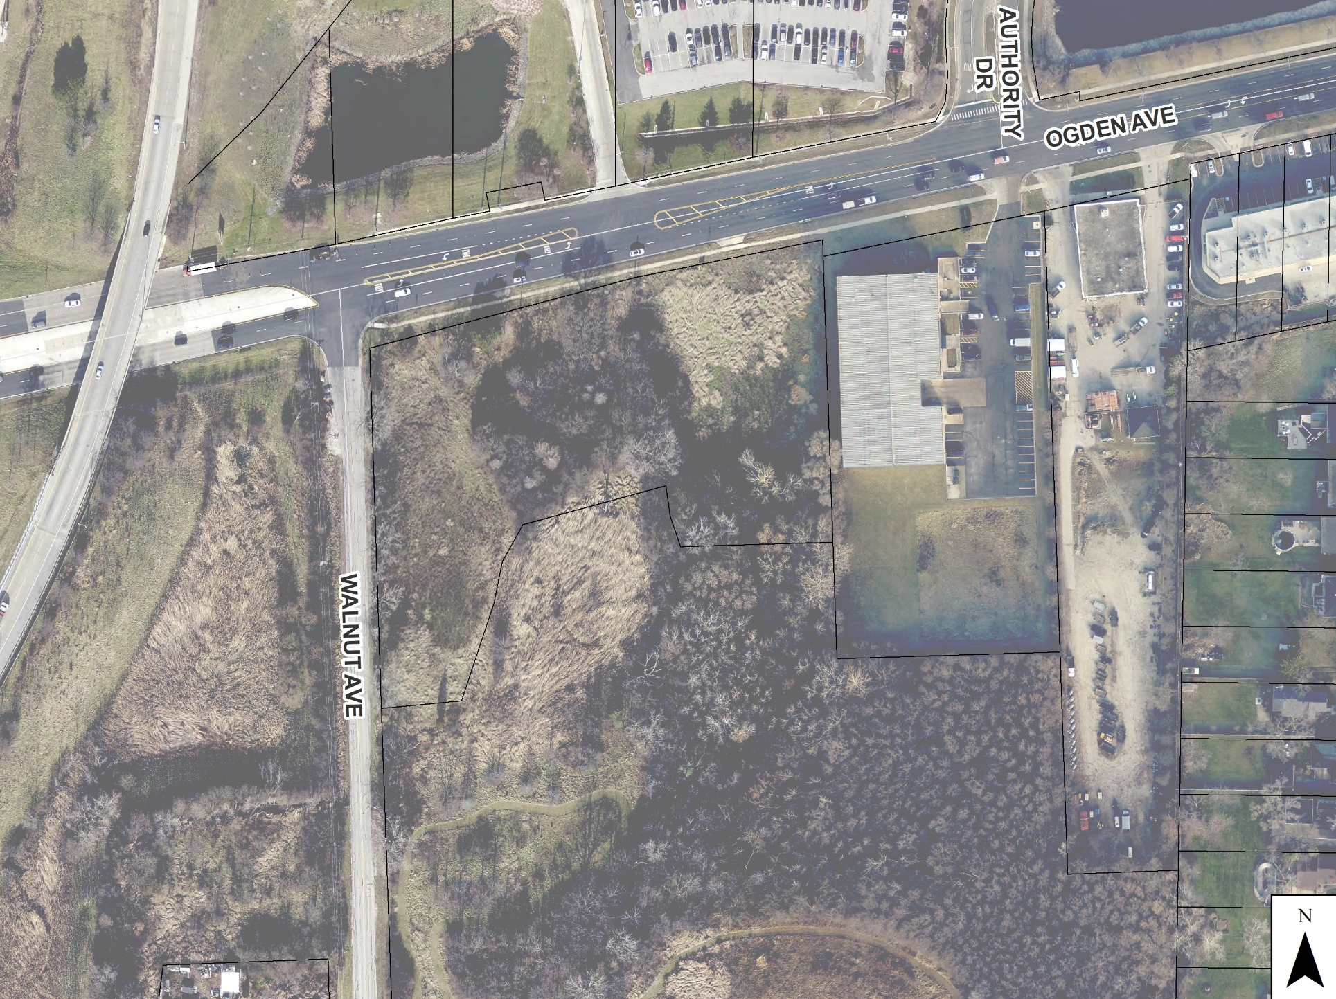
2751 – 2761 Ogden Ave

Slide 5
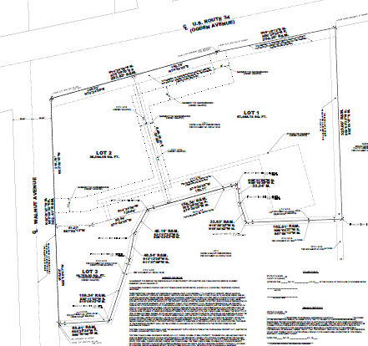
2751 – 2761 Ogden Ave
Lot 1
Lot 2
Lot 3

Slide 6
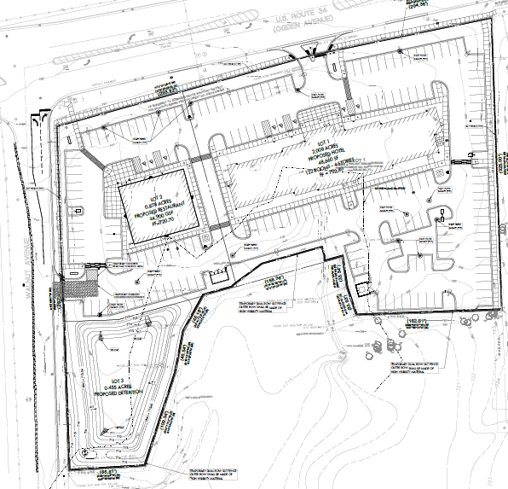
2751 – 2761 Ogden Ave
Future Park District
Development Site

Slide 7
2751 – 2761 Ogden Ave
Future Park District
Development Site

Slide 8
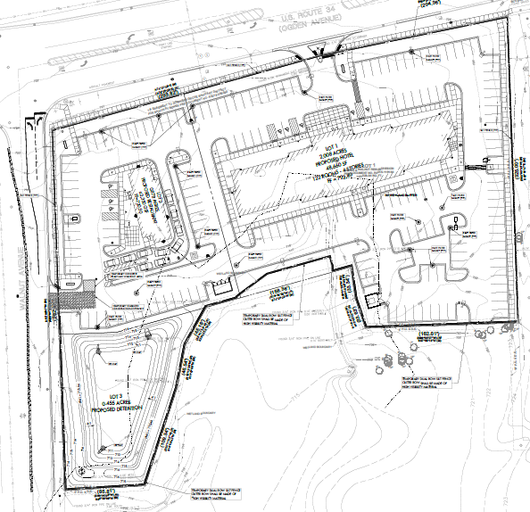
2751 – 2761 Ogden Ave
Future Park District
Development Site

Slide 9
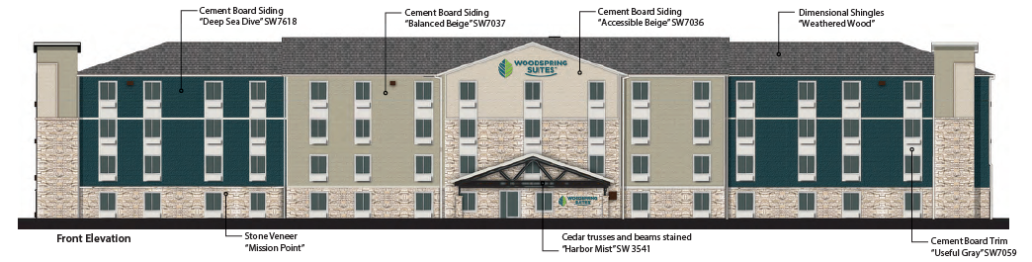
2751 – 2761 Ogden Ave

Slide 10
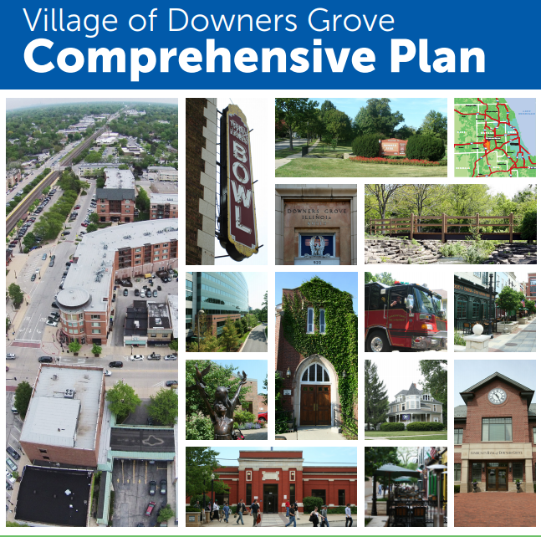
2751 – 2761 Ogden Ave
  Catalyst Site D1
    Anchors west end of Ogden
    Striking building
    Landmark for drivers on I-355
  Maximizes exposure to I-355
  Neighborhood & Regional service
  Beautifies Ogden Avenue
  Provides connections to future Park District development

Slide 11
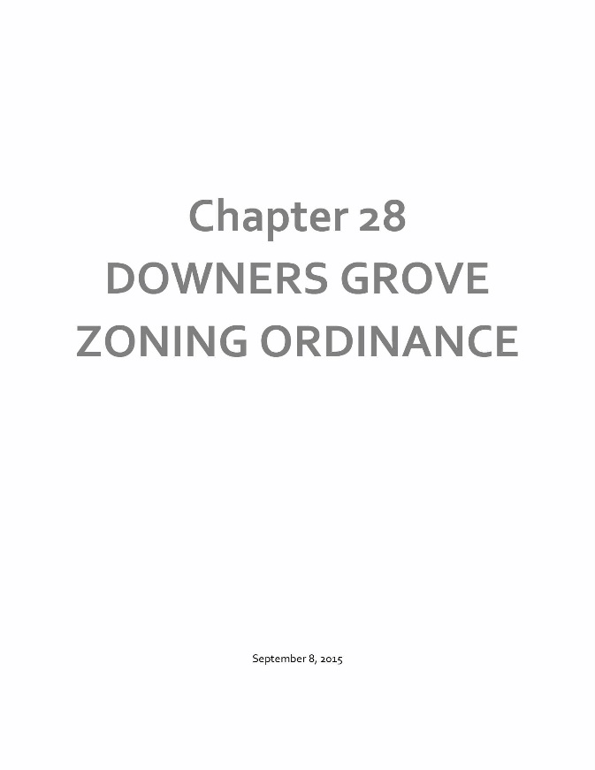
2751 – 2761 Ogden Ave
Plat of Subdivision
  Section 20.301
Planned Unit Development
  Section 28.12.040.C.6
Rezoning
  Section 28.12.030.I
Special Use
  Section 28.12.050.H
Chapters 20
&
28
Subdivision
Ordinance
&
Zoning
Ordinance

Slide 12
Village Council
Meeting
October 5, 2021

